Slide 1
Management Information Systems
Prasad Padalkar
Module 3: Ethical issues and Privacy

Slide 2
Topics
Information Security
Threat to IS
Security Controls

Slide 3
What is Information Security?
Security can be defined as the degree of protection against criminal activity, danger, damage, and/or loss.
Information security refers to all of the processes and policies designed to protect an organization’s information and information systems (IS) from unauthorized access, use, disclosure, disruption, modification, or destruction.

Slide 4
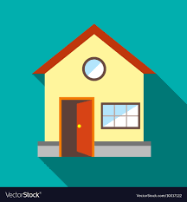
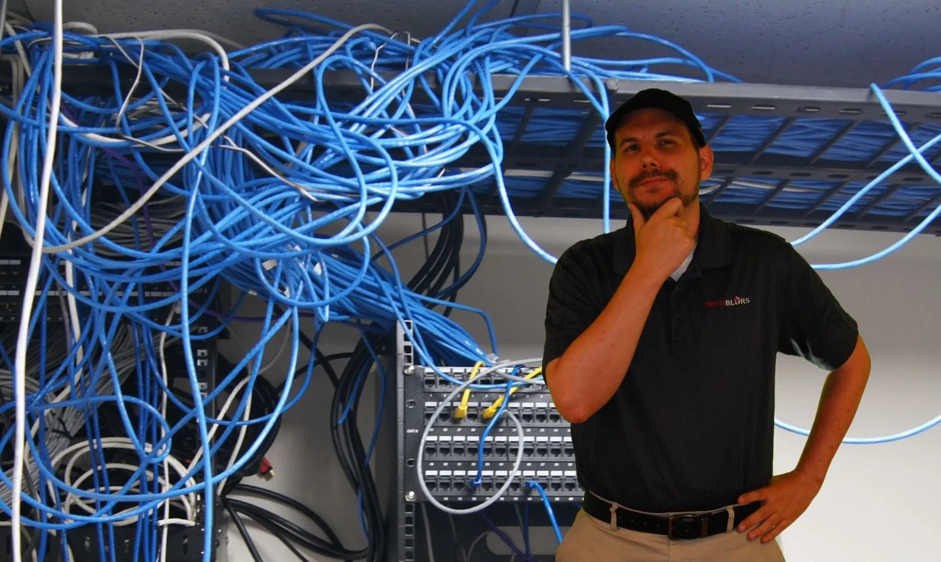
Vulnerabilities
A vulnerability refers to a weakness or flaw in a system, network, application, or process that can be exploited by an attacker to gain unauthorized access, cause damage, or perform malicious activities.

Slide 5


Threat
A cybersecurity threat refers to any situation or occurrence that can have negative consequences for a business's operations, functions, brand, reputation, or perceived image. Such a threat may also affect data access, integrity, and value, as well as the people, processes, and technologies involved in managing that data.
Adversarial (Deliberate)
Non - Adversarial (Unintentional)

Slide 6

Exploit
An exploit (action to take advantage) is a defined way to breach the security of an IT system through a vulnerability. Ex. buffer overflow flaw can be exploited An exploit could be a piece of code available on the internet to execute such attack against an application that happens to be vulnerable.

Slide 7
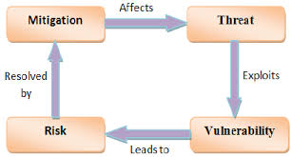
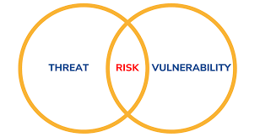
Risk
A risk is the probability of an event or that an event could actually happen. In this case, the likelihood of a vulnerability to be exploited.
Vulnerability (Severity) x Threat (likelihood) = Risk ( Priority)

Slide 8
Increase in Vulnerability
Factors affecting the increase in computer vulnerability
Interconnected, interdependent, wirelessly networked business environment;
Smaller, faster, cheaper computers and storage devices;
Easy to acquire skills necessary to be a computer hacker;
International organized crime taking over cybercrime;
Lack of management support.

Slide 9
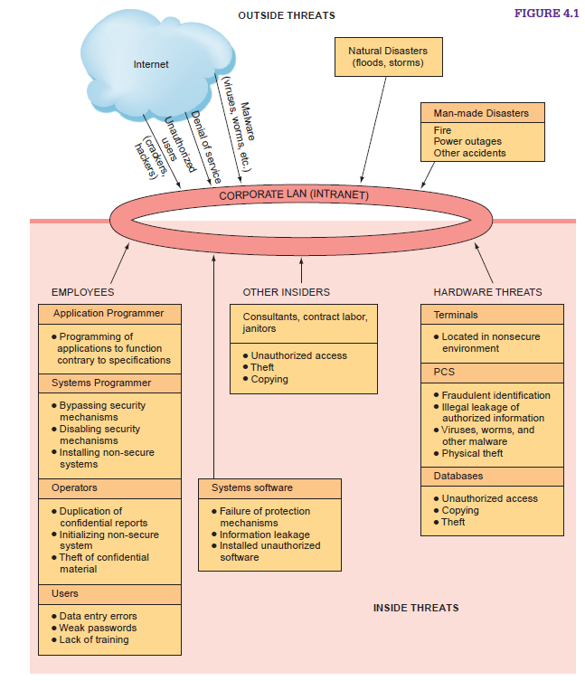
Unintentional Threats to Information Systems
Two categories of threat
Unintentional threats
Deliberate threats

Slide 10
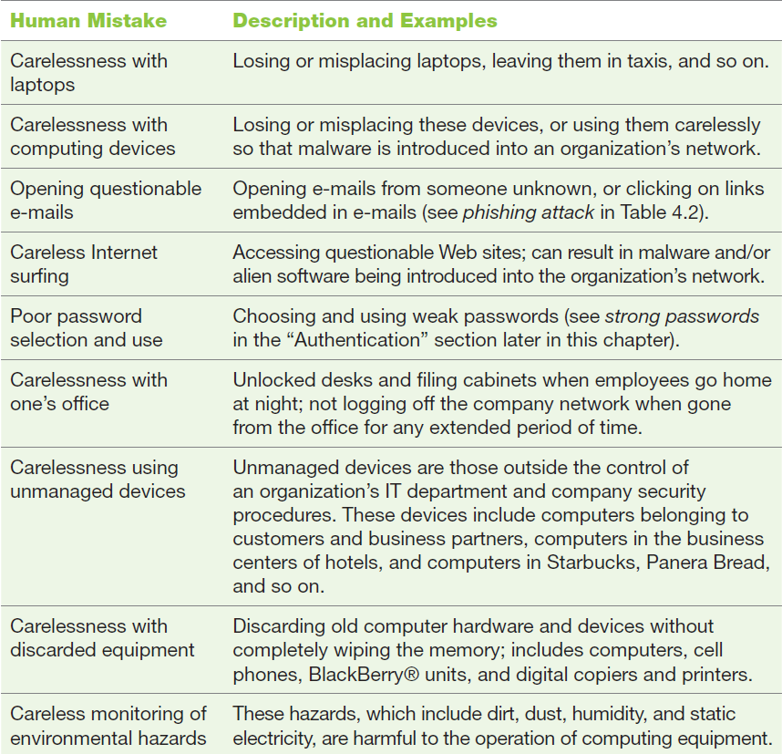
Human Error
Human errors or mistakes by employees pose a large problem as the result of laziness, carelessness, or a lack of awareness concerning information security

Slide 11
Social Engineering
Social engineering is an attack in which the perpetrator uses social skills to trick or manipulate legitimate employees into providing confidential company information such as passwords.
https://www.youtube.com/watch?v=fHhNWAKw0bY

Slide 12
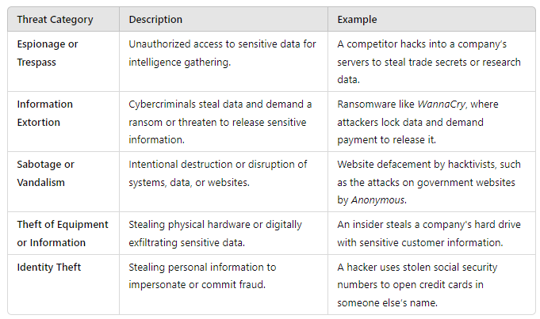
Deliberate Threats

Slide 13
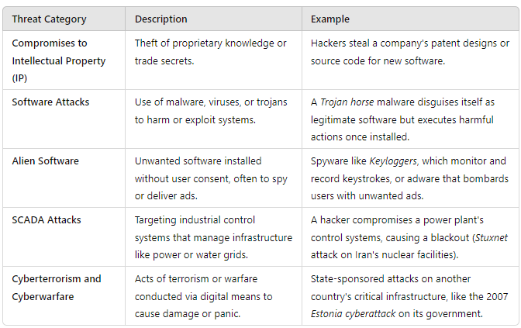
Deliberate Threats

Slide 14
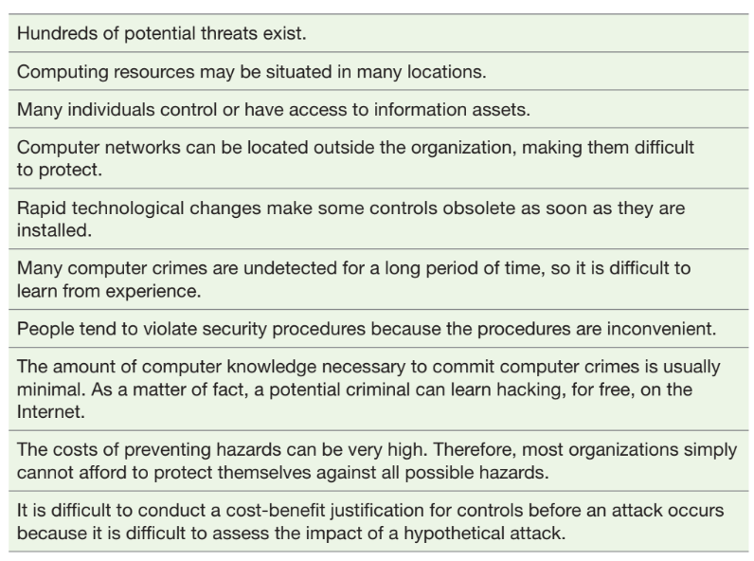
Challenges in the Information Security

Slide 15
What is Risk Management ?
Risk management is the process of identifying, assessing, and controlling risks to minimize the impact of potential threats on an organization or system.

Slide 16
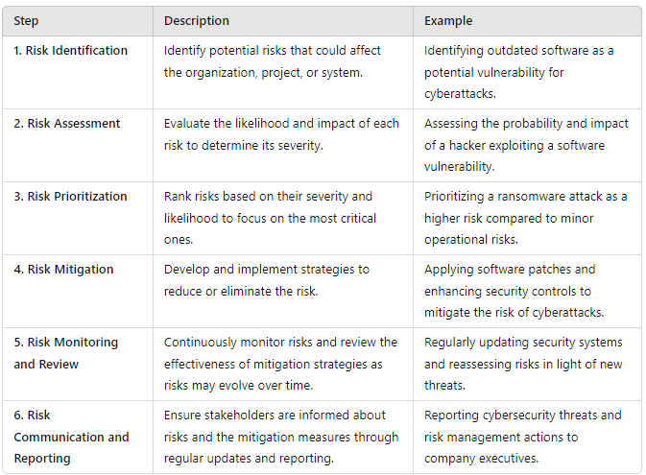
RISK Management Steps

Slide 17
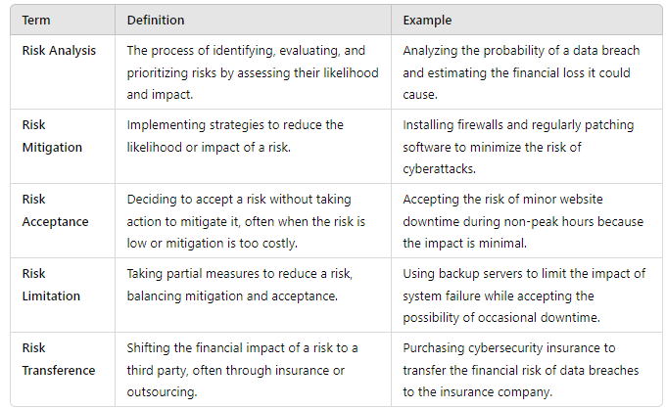
Key Terms in Risk Management

Slide 18
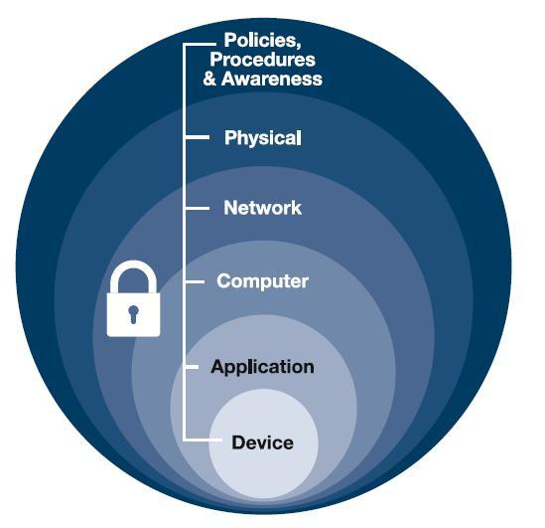
Controls
To protect their information assets, organizations implement controls, or defense mechanisms (also called countermeasures). These controls are designed to protect all of the components of an information system, including data, software, hardware, and networks.
Defense in depth is a strategy that leverages multiple security measures to protect an organization's assets.

Slide 19
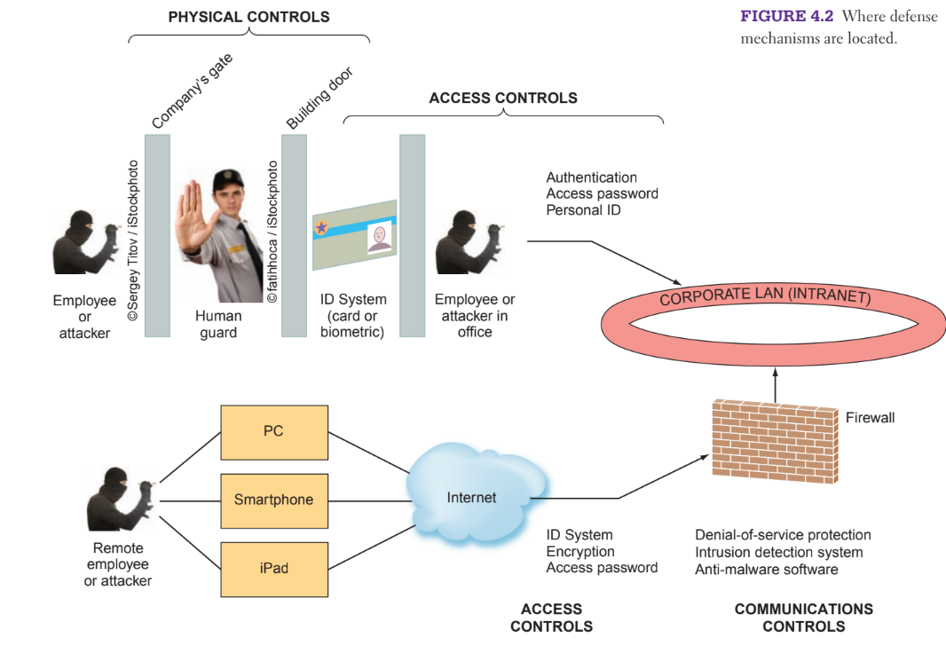
Controls
Three major types of controls:
physical
access controls,
communications

Slide 20
Physical Controls
Physical controls prevent unauthorized individuals from gaining access to a company’s facilities.
Common physical controls include walls, doors, fencing, gates, locks, badges, guards, and alarm systems.

Slide 21
Access Control
Access controls restrict unauthorized individuals from using information resources.
These controls involve two major functions: authentication and authorization.
Along with these two keeping track of activities is also legally important, hence we have Accounting.

Slide 22
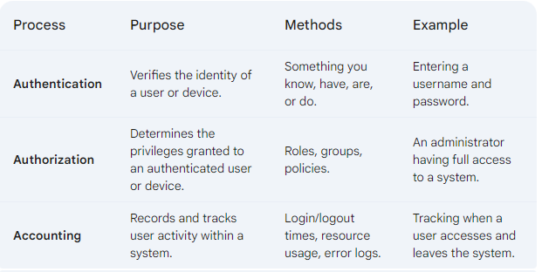
Access Control – AAA

Slide 23
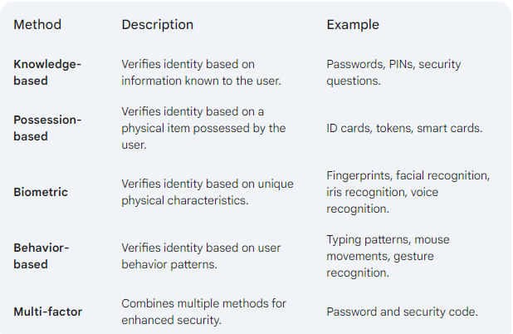
Access Control - Methods of Authentication

Slide 24
Communication Controls
Communications controls (also called network controls) secure the movement of data across networks.
Communications controls consist of firewalls, anti-malware systems, whitelisting and blacklisting, encryption, virtual private networks (VPNs), secure socket layer (SSL), and employee monitoring systems.

Slide 25
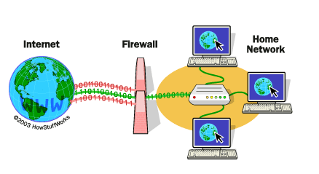
Communication Controls - Firewall
Firewall is a network security device that monitors and controls network traffic. It acts as a barrier between a trusted network (e.g., your internal network) and an untrusted network (e.g., the internet).

Slide 26
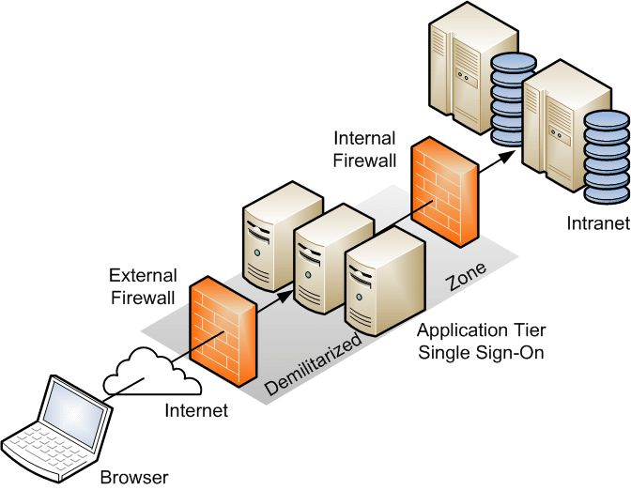
Communication Controls - Firewall(DMZ)
Demilitarized Zone
A DMZ is a network segment that separates a trusted internal network from an untrusted external network (typically the internet). It creates a buffer zone where traffic can be inspected and filtered before it reaches the internal network

Slide 27
Communication Controls - Anti-Malware System
Anti-malware systems, also called antivirus, or AV, software, are software packages that attempt to identify and eliminate viruses and worms, and other malicious software.
For. e.g.
Norton 360: A comprehensive security suite that includes antivirus, firewall, VPN, and other features.
Kaspersky Lab: Offers a range of security products for both personal and enterprise use.
McAfee: Provides antivirus, firewall, and other security solutions.

Slide 28
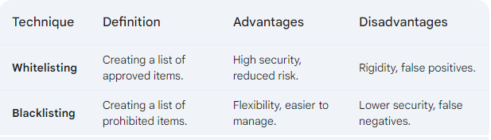
Communication Controls - Whitelisting & Blacklisting

Slide 29
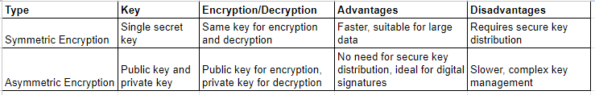
Communication Channels - Encryptions
Encryption is the process of converting plain text (readable data) into ciphertext (unreadable data) using a mathematical algorithm.

Slide 30
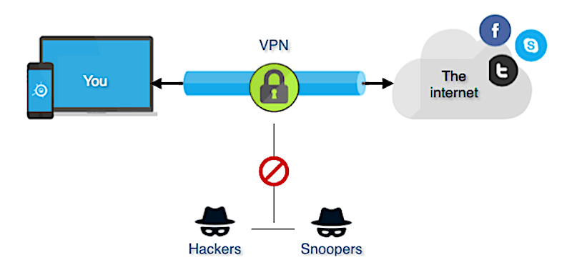
Communication Channels - Virtual Private Network(VPN)
A VPN creates a secure, encrypted connection between your device and a remote network. This allows you to access the internet with a different IP address, bypassing geographical restrictions and potentially improving privacy and security.

Slide 31
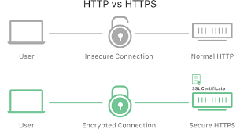
Communication Channels - Secure Socket Layer (SSL)
SSL (Secure Sockets Layer) and TLS (Transport Layer Security) are cryptographic protocols that provide secure communication over a computer network.
They are primarily used to establish encrypted connections between a web server and a web browser, ensuring that data transmitted between them is secure and confidential.

Slide 32
Business Continuity Plan
A Business Continuity Plan (BCP) is a comprehensive document outlining strategies and procedures that an organization can implement to maintain critical business operations in the event of a disruption or disaster.
The goal of a BCP is to minimize the impact of a disruption and ensure that the organization can recover its operations as quickly as possible.
For. e.g. Risk Assessment is carried out to identify potential causes of power outages, such as natural disasters or equipment failures.

Slide 33
Disaster Recovery Plan
A Disaster Recovery Plan (DRP) is a subset of a Business Continuity Plan (BCP) that specifically focuses on the technical aspects of recovering IT systems and data in the event of a disaster.

Slide 34
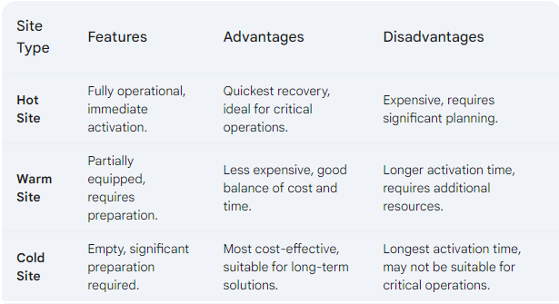
Disaster Recovery Plan

Slide 35
Information Systems Auditing
Information systems auditing is the process of examining and evaluating an organization's information systems to ensure they are operating effectively, efficiently, and securely. It involves assessing the controls, processes, and procedures in place to protect data, maintain system integrity, and comply with relevant regulations.

Slide 36
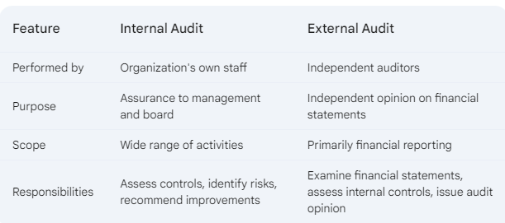
Information Systems Auditing - Types of Audits

Slide 37


